Slide 1

Impact of Taylor Swift on the Chiefs and Super Bowl LVIII
By: Christopher Abbes, Davis Bove, and Megan Gibson

Slide 2





Overview
Background
Taylor Swift Earnings
Chiefs Ticket Prices
Super Bowl Views
Conclusion

Slide 3
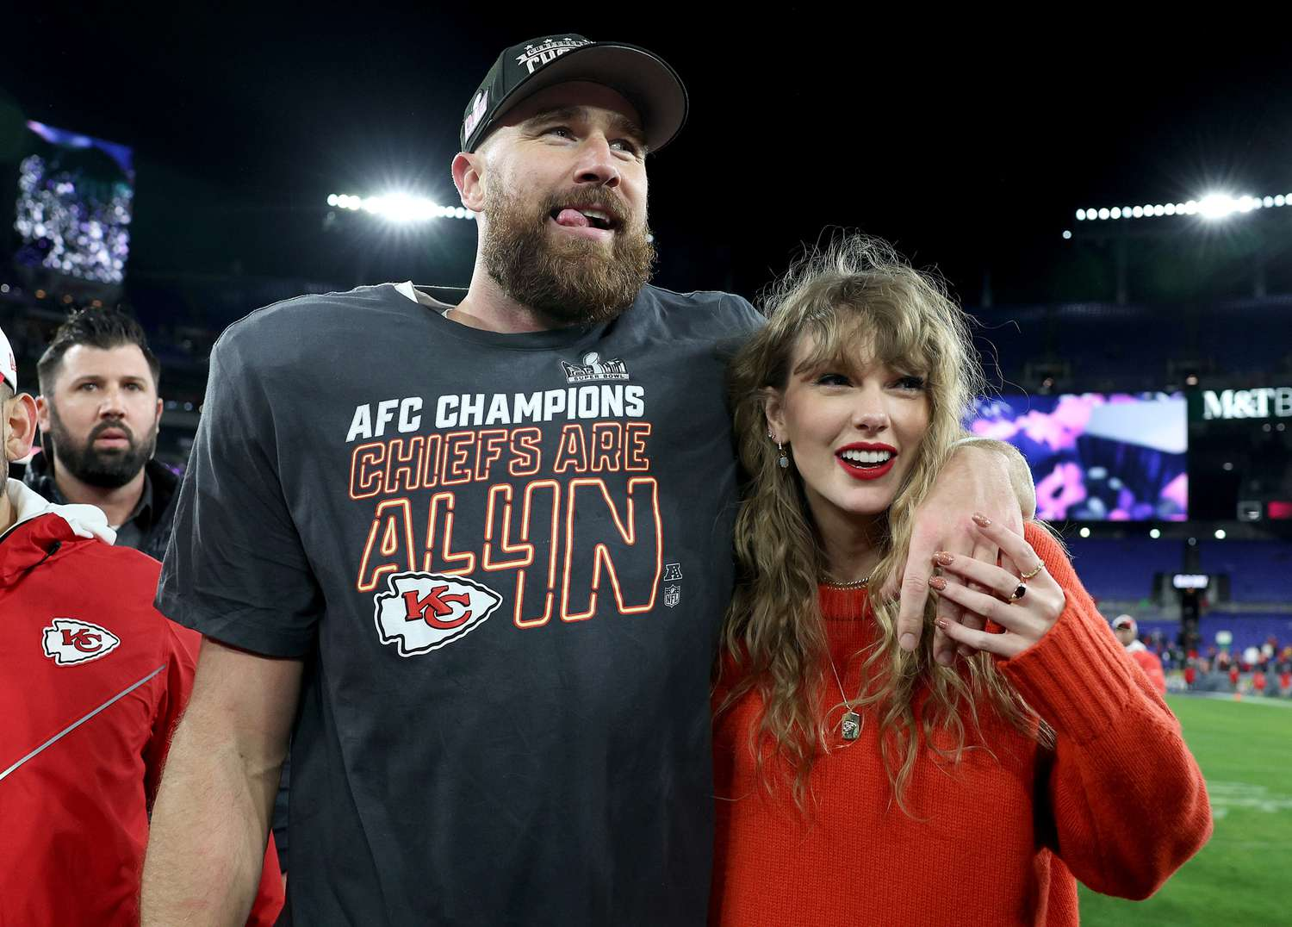
Background Information
Taylor Swift and Travis Kelce have been dating since September 2023.
Travis was playing in the 2023-2024 NFL season (which began that same month and concluded in February 2024 with the Super Bowl) for the Kansas City Chiefs and Taylor was performing in her Eras Tour (which began in March 2023 and will last until December 2024).
Notes:
First let’s give some background information. So Taylor Swift and Travis Kelce have been dating since September 2023. At the time, Travis was playing for the Kansas City Chiefs in the 2023-2024 NFL season which began that same month and concluded in February of this year with the Super Bowl. Taylor was performing in her Eras Tour which began in March 2023 and will last until December of this year. Now this relationship has been much talked about in the media and has made Kelce a household name even to non-NFL fans. However, we want to see whether data really supports the idea that this relationship has tangibly boosted Kelce’s career, which we have measured in the form of Chiefs’ ticket prices and Super Bowl viewership numbers.

Slide 4
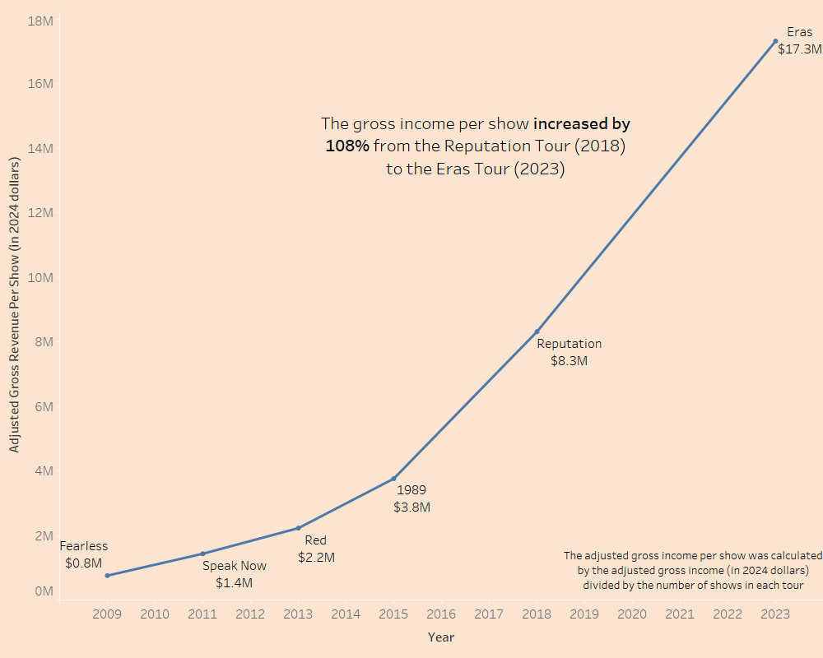
Taylor Swift Revenue per Tour (in 2024 $)
Eras is Taylor’s highest-grossing tour to date, even considering inflation
Eras began in Mar ’23, six months before she started dating Travis
Clearly she is doing quite well for herself
Billboard
Pollstar
Variety
Notes:
But first, let’s talk about Taylor for a moment. This graph shows Taylor Swift’s average gross revenue per show for each tour, which we calculated by simply dividing the total revenue for each tour (adjusted for inflation in 2024 dollars) by the number of shows that tour had. As you can see, the increase from Reputation in 2018 to Eras in 2023 was the most stark, increasing by 108%. Eras is her highest-grossing tour to date, even accounting for inflation, and began six months before she started dating Travis. So clearly Taylor is doing quite well for herself.

Slide 5
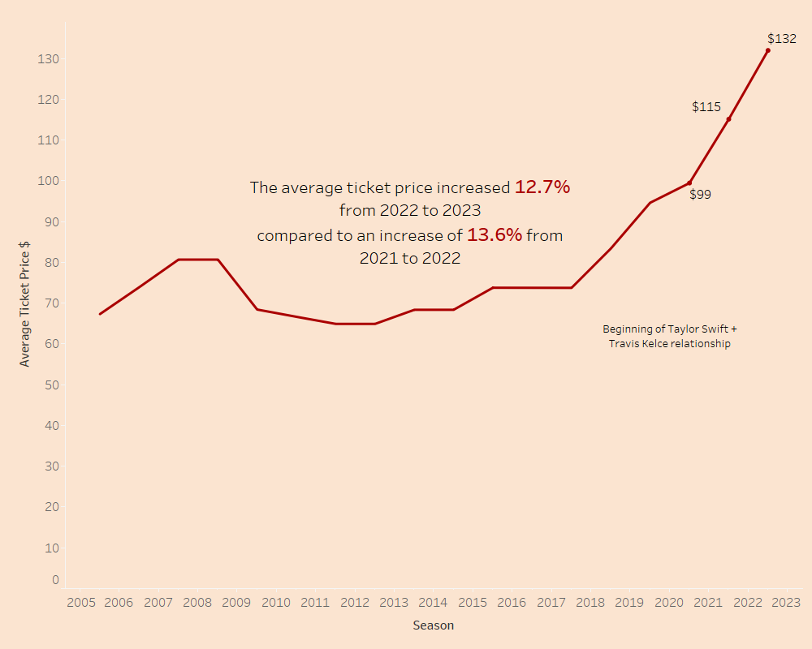
Did Taylor help the Chiefs’ ticket price?
Chiefs recorded highest avg. ticket sales in 2023 season
Price has been rising in recent history
Increase from ’22 - ’23 not significantly greater than previous
Source:
Statistica
Notes:
Chiefs ticket sales have shown a constant increase since 2013. This is the first year that the chiefs had started to make the playoffs consistently. The most dramatic increases started to take place in 2019 after the chiefs had won their first super bowl. This increase was still not quite as dramatic as the one that took place from the 2021-2022 seasons. The ticket prices in the 2022 increased by 13.6% to and average price of $115 from $99 per ticket the year before Travis and Taylor Started to date. The 2023 prices increased still a very good amount from $115 to $132 but it is only 12.7% increase. The 2023 season may have had the highest season average ticket price that the chiefs have had, but the increase was less than the year before so the Travis and Taylor Romance does not seem to be playing a beneficial role for ticket prices.

Slide 6
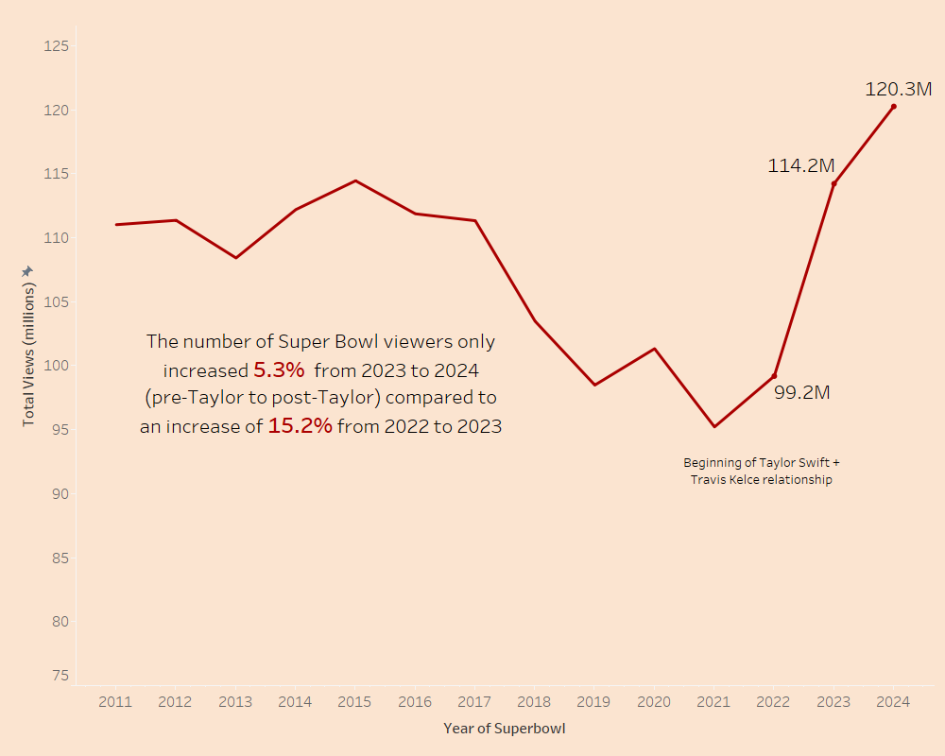
Did Taylor really impact Super Bowl viewership?
Talk of many T. Swift fans watching Super Bowl
Possible engagement
Views rose from ’23 - ’24 but not as much as previous year
2019, 2021 saw lower views than normal
Source:
SportsMedia Watch
Notes:
Media made it seem like many people who usually did not tune into the super bowl were watching because they were taylor swift fans because of the excitement around the relationship and taylor swift hype. There was talk of taylor and travis getting engaged if the chiefs won the super bowl
The views did rise from 2023 -24 but not as much as 22- 23. These are two very comparable super bowls because the Cheifs were in both of them, and there was not much else to raise or lower views of the superbowl for example 2021 saw lower viewing because the COVID 19 pandemic affected the season, and 2019 saw lower views because it was regarded as one of the most boring Super bowls in recent history.
The point is that post taylor + travis, the super bowl views did not see an incredible increase when looking at the trends from recent history.

Slide 7
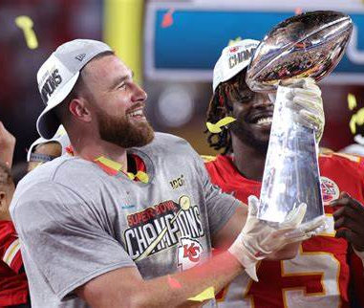
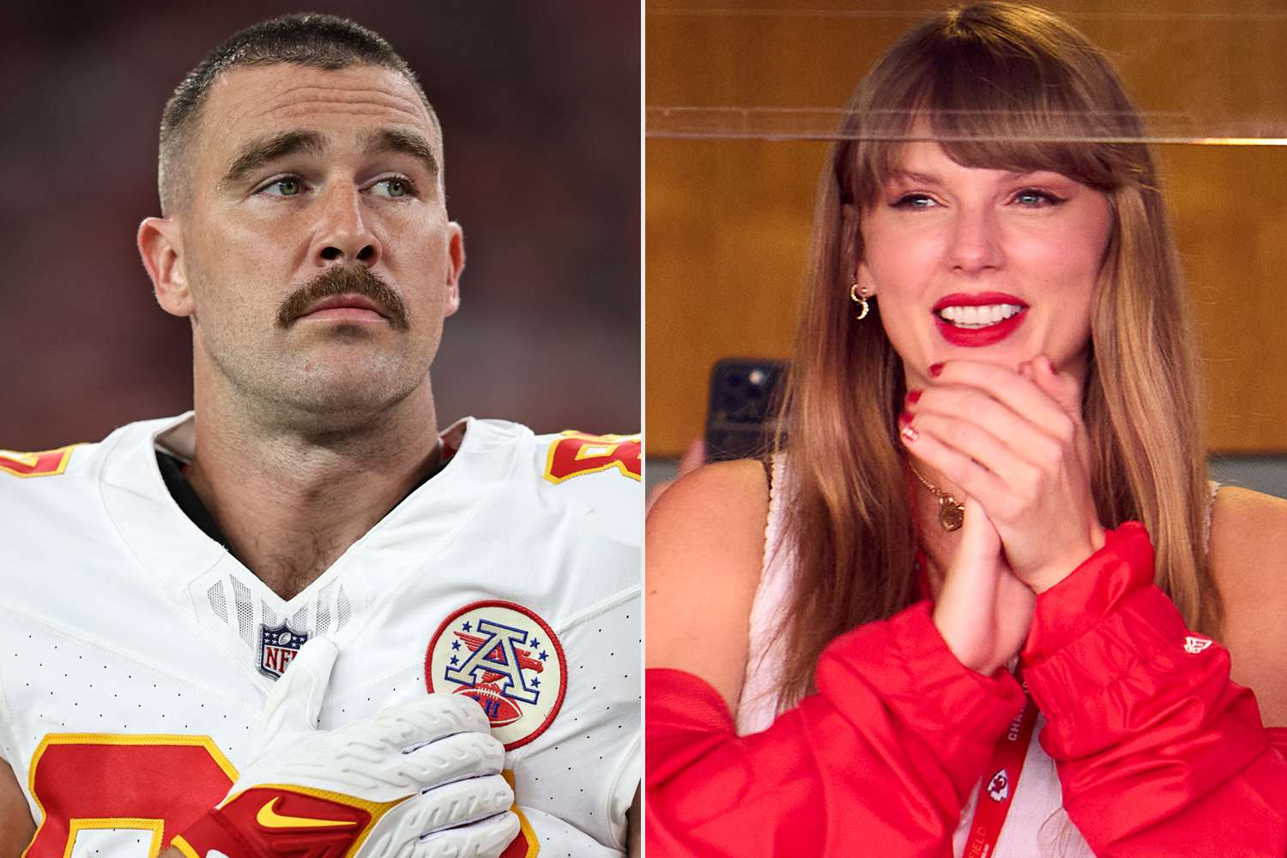

Conclusion
Based on the data, the relationship between Taylor Swift and Travis Kelce did not significantly impact either Super Bowl viewership or the Chiefs’ ticket prices as much as the media made it seem.

